Slide 1
Lived Experience Member Onboarding
Notes:
Turn on the recording! LCCH Logo here.

Slide 2
Introductions
Me
You
How you would like to be addressed
How you would like to be introduced

Slide 3
Tech Assistance
Zoom Beginner's Guide
Zoom Accessibility & Function Tips
Showing clickable links: click here
You should have received this slide deck in your email, but you can also access it here on our website.
We are working on a relationship with Waukegan Libraries where you can pick up a printed-out version of this if you would like. Would that be helpful for you?

Slide 4
Contents
Homelessness in Lake County & Nationally
Coordinated Entry System
The By-Name List
The Housing Placement Process
Lake County Coalition for the Homeless Governance
Meeting Guidelines and Resources
Disclaimers
CoC Policies & Bylaws
Buddy System
Payment
What is a CoC?

Slide 5
Homelessness in Lake County
In FY2023, 564 assessments were completed with 562 exits from the system. ​
Of the 548 unique households that exited the system, 205 unique households exited to permanent destinations.​
89 of the above exits to permanent destinations are through Coordinated Entry.​
53 Chronic at Entry 18% Decrease from FY22 (64 in FY22 to 53 in FY23)
35 Parenting Youth 40% increase from FY22 (25 in FY22 to in 35 FY23)
19 Veterans 35% increase from FY22 (14 in FY22 to 19 in FY23)
65 Youth HoHs 18% increase from FY22 (56 in FY22 to in 65 FY23)
257 Families 75% increase from FY22 (148 in FY22 to in 257 FY23)

Slide 6
Homelessness Nationally
On a single night in 2023, roughly 653,100 people – or about 20 of every 10,000 people in the United States – were experiencing homelessness
Experiences of homelessness increased nationwide across all household types. Between 2022 and 2023, the number of people experiencing homelessness increased by 12 percent, or roughly 70,650 more people.
Seven in ten people experiencing homelessness (72%) did so in households without children present.
Nearly three of every 10 people experiencing homelessness (28% or roughly 186,100 people) did so as part of a family with children.
On a single night in 2023, more than 34,700 people under the age of 25 experienced homelessness on their own as “unaccompanied youth.”

Slide 7
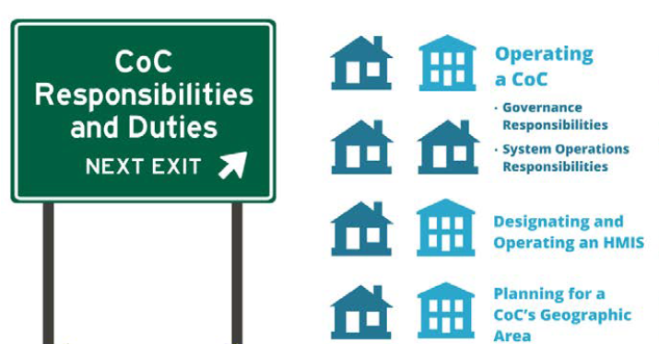
What is a Continuum of Care?
According to the United States Department of Housing and Urban Development (HUD), a Continuum of Care (CoC) is “a community plan to organize and deliver housing and services to meet the specific needs of people who are homeless as they move to stable housing and maximize self-sufficiency. It includes action steps to end homelessness and prevent a return to homelessness.”

Slide 8
The Four Parts of a Continuum
CoCs are tasked to can track and manage the homeless community in their area. This provides an overview of the state of homelessness in a CoC, and offer the information necessary to redirect services, funding, and resources as necessary. HUD identifies four necessary parts of a continuum:
Outreach, intake, and assessment in order to identify service and housing needs and provide a link to the appropriate level of both;
Emergency shelter to provide an immediate and safe alternative to sleeping on the streets, especially for homeless families with children;
Transitional housing with supportive services to allow for the development of skills that will be needed once permanently housed; and
Permanent supportive housing to provide individuals and families with an affordable place to live with services if needed.

Slide 9
Our CoC: Lake County Coalition for the Homeless
An independent non-profit that unites agencies in the goal to eliminate homelessness in Lake County through the provision of leadership in the areas of assessment, advocacy, and community education.
Member Organizations:
City of Waukegan
Independence Center
Ascension
Community Partners for Affordable Housing
Lake County Haven
PADS Lake County
Waukegan Township
Catholic Charities
Prairie State Legal Services
Lake County Health Department & Community Health Center
Kids Above All
Family First Center of Lake County
Notes:
LOGOS for membership organization

Slide 10
Coordinated Entry System
Per the U.S Department of Housing and Urban Development’s (HUD) Continuum of Care (CoC) Program interim rule, each CoC is required to implement a coordinated entry system that covers the geographic area of their CoC.
Coordinated entry is a process developed to ensure that all people experiencing a housing crisis have fair and equal access and are quickly identified, assessed for, referred, and connected to housing and assistance based on their strengths and needs. Coordinated entry processes also provide information about service needs and gaps to help communities plan their assistance and identify needed resources.

Slide 11
Coordinated Entry System Goals
The System Coordination and Entry Committee was convened by the Lake County Coalition for the Homeless to achieve the following goals:
To bring Lake County in compliance with Federal Regulations regarding coordinated assessment/entry that require “a centralized or coordinated process designed to coordinate program participant intake, assessment, and provision of referrals. A centralized or coordinated assessment system covers the geographic area, is easily accessed by individuals and families seeking housing or services, is well advertised, and includes a comprehensive and standardized assessment tool.”.
Minimize barriers faced by individuals who are homeless in accessing the most appropriate and effective housing services to address their needs.
Incorporate a “housing first” philosophy in matching homeless individuals with services.
Use ServicePoint (also known as the Homeless Management Information System) to maximize existing resources and simplify implementation.
Notes:
Explain Housing First.

Slide 12
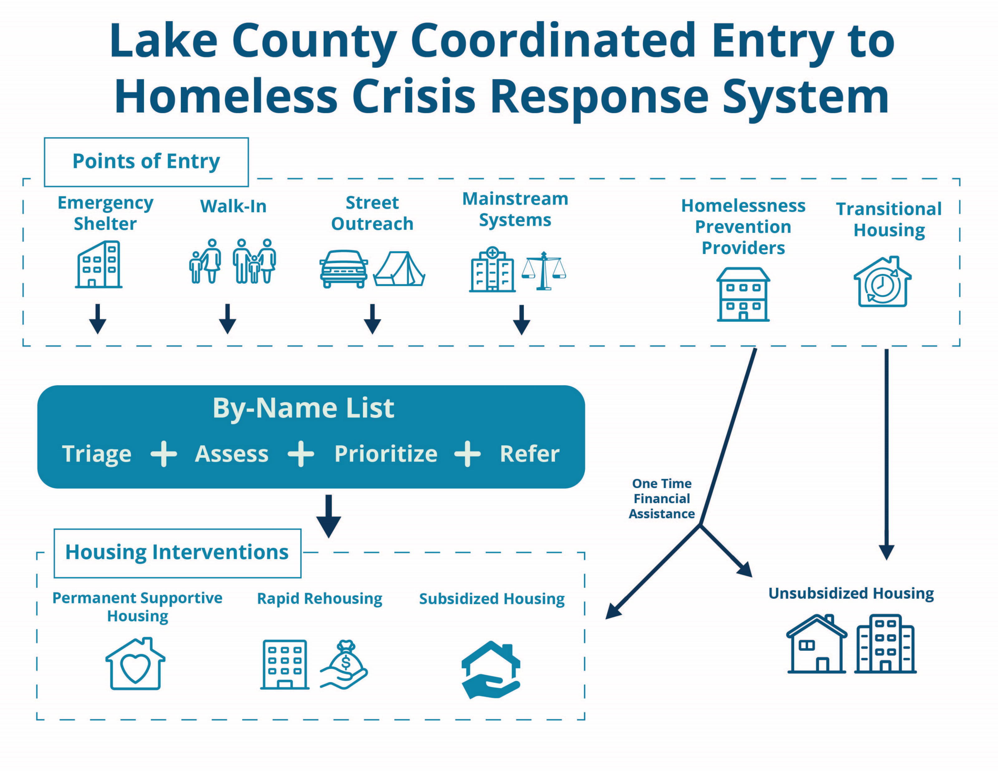

Slide 13
The By-Name List
The By-Name List is an active list of everyone who is experiencing literal homelessness in Lake County that updates every day.
Clients enter the By-Name List from a Point of Entry Sites:
PADS, A Safe Place, Lake County Haven, Public Defender’s Office, Veterans Path to Hope, Catholic Charities, Nicasa, or the VAC, the VA.
Clients must be experiencing literal homelessness upon program intake:
Clients who are staying at a shelter, safe haven or place not meant for human habitation.
Staying in a motel paid for by a charitable organization (not self, family or friends)
Staying in an institutional setting (Jail, Hospital, etc.) for less than 90 days AND literally homeless before entering that institutional setting

Slide 14
Housing Placement Process
VACANCY
Programs have or anticipate program vacancy
Notify BNL Coordinator
REFERRAL
Referrals from BNL in Lake County
REVIEW
Housing Placement Work Group provides immediate oversight
Prioritized by vulnerability
Coordinated Entry Committee provides system monitoring and policy oversight

Slide 15
Lake County Coalition for the Homeless Governance Model
Steering Council
Strategic Planning & System Performance Committee
Homeless Management Information System (HMIS) Committee
Project Performance and Monitoring Committee
System Coordination and Entry Committee
Community Engagement, Advocacy and Membership Committee
LCCH Board of Directors
Chair
Chair
Chair
Officers:
-President
-Vice-President
-Secretary
-Treasurer
Chair
Chair
Notes:
Drop in chat - https://www.lakecountyhomeless.org/

Slide 16
LCCH Committees
Strategic Planning & System Performance Committee will oversee the strategic planning process, analyze trends and data, and make recommendations on allocation of resources irrespective of particular projects.
HMIS Committee will oversee the Homeless Management Information System (HMIS) for the Continuum of Care, and any other related uses of the system.
Project Performance & Monitoring Committee will review projects funded by the Continuum of Care, Emergency Solutions Grant, or other related projects for compliance, appropriateness, and performance, as well as make recommendations on allocation of resources specific to particular projects.
System Coordination & Entry Committee will provide oversight of the coordinated entry/assessment process for the Coalition as well as coordination with other systems which may discharge people in to homelessness.
Community Engagement, Advocacy and Membership Committee will be responsible for external and community relations, as well as membership management and elections.

Slide 17
LCCH Elected Leadership Roster
President: Eric Foote, PADS
Vice President: Dr. Garcia, A Safe Place
Secretary: Sindy Guerra, Nicasa
Treasurer, Kate Ceithaml, Lake County Haven
Strategic Planning & System Performance Committee: Nestor Sagun, PADS
HMIS Committee: Karina Galindo, PADS
Project Performance & Monitoring Committee: Gregorio Resendiz, Independence Center
System Coordination & Entry Committee: Stephanie Schlappi, Catholic Charities
Community Engagement, Advocacy and Membership Committee: Jim Menzer, Regional Office of Education

Slide 18
LCCH Meeting Map

Slide 19
Responsibilities of All Members
One vote per person & agencies get one vote
Must follow the Code of Conduct and Conflict in Interest Policy
Entry Points are required to participate in Coordinated Entry Committee
Housing Providers are required to participate in Housing Placement Work Group Meetings
Notes:
Members must act professionally with integrity, honesty, truthfulness and adherence to the absolute obligation to safeguard the public trust, and demonstrate concern for the interests and well-being of individuals affected by their actions.

Slide 20
Best Practices for Board and Committee Meetings
In order to facilitate the smooth running of LCCH meetings, there are a number of etiquette tips for those in attendance that should be adhered to facilitate productivity:
Some agendas will identify allocated time per agenda item. Some meetings also have timekeepers who will let us know how much time there is left in a section.
Refrain from texting, calling, or engaging in side conversations unless it is urgent.
When possible, prepare for meetings by reviewing the agenda beforehand.
On virtual meetings, feel free to use the mute button if you’re in a noisy area.
Ensure you know what you will be voting on and have a clear idea of the issues.
If you have a question, feel free to speak up during a meeting and ask.
Some member meetings will have a member comments section. This section can be used for an item you would like to bring up that is not on the agenda.
Keep in mind the shared vision and mission, even though we may have different opinions on how to reach the same goal.
Take breaks when needed, especially if you’re feeling emotional. Feel free to say you are taking a short break.
Participate in active listening: Listen to understand, not to respond.

Slide 21
Meeting Term Definitions
What is considered a quorum?
The quorum is the number of members required to be present to be able to pass resolutions and other votes.
Per Diem definition:
by the day : for each day
Pro rata definition:
proportionately according to an exactly calculable factor (such as share or liability)

Slide 22
Acronym Guide
General HMIS/Continuum of Care Acronym
FLF: Finish Line Funds
LRMF: Landlord Risk Mitigation Fund
MVP: Mainstream Voucher Program
FSV: Fair Share Vouchers
ASP: A Safe Place
KPI : Key performance indicator
LCHD: Lake County Health Department
LCHA: Lake County Housing Authority
CPAH: Community Partners for Affordable Housing
CAP: Community Action Partnership
CC: Catholic Charities
VAMC: Veterans Affairs Medical Center
FACC: Federal Health Care Center
HAP: Housing Assistance Payment
VASH: Veterans Affairs Supportive Housing
SCEC: System Coordination and Entry Committee
PPM: Project Performance and Monitoring Committee
HMIS Committee: Homeless Management Information Systems Committee
CEAM: Community Engagement Advocacy and Membership Committee
SPSP: Strategic Planning and System Performance Committee

Slide 23
Get Involved!
Attend our board meetings to get an understanding of the Coalition as a whole.
Join a committee or work group to start making a difference in an area you care about.
Committee and board meeting dates on the website at www.lakecountyhomeless.org/calendar
Request to be put on a recurring calendar invite for a committee so you never have to miss a meeting!
You do not need to be a member to attend a committee meeting. These are open to the public.
Only members have voting power.

Slide 24
Disclaimers
The Coalition cannot address individual housing needs. Being a member of the Coalition does not result in any special eligibility for programs that serve people experiencing homelessness, however organizations within the Coalition may be able assist you. Please refer to the list of agencies on 211.
This pilot is run on limited funds and may be subject to a cap on compensation
Resources
Renter’s Resource Packet
Job Center of Lake County
211 Website
Food pantries & Soup Kitchens
PADS Shelter
Case Management Appointments from 10am until 4pm
1800 Grand Ave, Waukegan, IL 60085, USA
(847) 689-4357

Slide 25
CoC Policies & Bylaws
A Summary of our Bylaws can be read here.
Other CoC Policy documents can be found on our website.

Slide 26
Buddy System
The Chair of the Community Engagement, Advocacy and Membership Committee (CEAM) runs a buddy system program that can pair you with a staff member at a Coalition member agency
Your buddy would be there to answer questions and check in with how you are settling into your membership role
Your participation in the buddy system can continue on for as long as you and your buddy find it helpful
Sign Up Here!

Slide 27
Payment Logistics
Please use this form to log your desired payment method
Every time you participate in a Coalition meeting, the chair or facilitator of the meeting you attended, will fill a form out that gets approved by the Treasurer and President of the Coalition. You can expect the treasurer to then facilitate payment.
Your attendance will be recorded in the meeting minutes for a Chair to look back on if necessary
Explaining when 1099 forms might be needed
We are happy to assist on an as needed basis with how compensation affects benefits

Slide 28
Questions?
Next Steps:
Getting you on an invite for the Committees you are interested in
Email introduction to the chair of the Committee you are interested in

